Slide 1
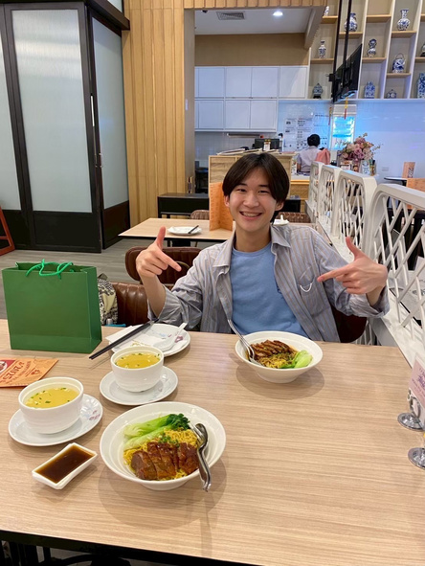




AWARDS
[Scholarship] Canada-ASEAN Scholarships and Educational Exchanges for Development (SEED)
Prize: 10200 CAD
Category: Individual
Organizer: The Government of Canada, with Global Affairs Canada and the Canadian Bureau for International Education (CBIE)
Year: 2025
Detail: Canadian government scholarship for University of Toronto Exchange Program
[Hackathon] Cyber Warrior Hackathon 2025: Honorable Mention Award (Top 10)
Prize: 10000 THB
Category: Team
Organizer: King Mongkut’s University of Technology Thonburi (KMUTT), in collaboration with the Cyber Crime Investigation Bureau (CCIB).
Year: 2025
Detail: Team award on the hackathon named Cyber Warrior Hackathon. Our team of 5 developed Tron Cryptocurrency tracking desktop application to track scammer’s transaction of cryptocurrency
[Hackathon] Hackathon & Pitching E-SAN Thailand PMU-B Coding & AI Academy Season 2: Social Impact Award + Gold Level Certificate
Prize: 3000 THB
Category: Team
Organizer: PMU-B in collaboration with Khon Kaen University, regional educational institutions, government agencies, and private sector partners
Year: 2025
Detail: Team awards. Our team of 3 developed an innovative crosswalk safety application
Patiharn Liangkobkit
Data Scientist & AI Engineer - Specialized in Artificial Intelligence (AI)
3+ years of experience in python and coding in multiple languages
1+ year of experience in data modeling and machine learning
1 year of international experience in United States
4 months of international experience in Canada as a computer engineering undergraduate in University of Toronto
Current GPA: 3.72
English Score:
  Duolingo English Test: 125 overall
    IELTS 6.5
    CEFR B2
    TOEFL iBT 93-97
Gmail: patiharn.liang@gmail.com
Tel: +66 63-614-5491
Github: Richyboy170
Address: 11/165 Nirvana Sathorn Kalapapruek Rd. Bangkhuntian Chomthong Bangkok 10150
COURSES & TRAININGS
Machine Learning
Title: Introduction to Machine Learning
Organizer: University of Toronto, Sep-Dec 2025
Deep Learning
Title: Applied Fundamentals of Deep Learning
Organizer: University of Toronto, Sep-Dec 2025
Python in Depth
Title: Programming Language
Organizer: University of Toronto, Sep-Dec 2025
AUTORULE, ML Technique from a Research Paper
Title: AUTORULE: Reasoning Chain-of-thought Extracted Rule-based Rewards Improve Preference Learning
Organizer: Eigen AI Conference’25 by UTMIST, Club in University of Toronto, 20 Sep 2025
Recommendation Systems
Title: Recommendation Systems: How Netflix Knows What You’ll Watch Next
Organizer: Eigen AI Conference’25 by UTMIST, Club in University of Toronto, 21 Sep 2025
Search Engine
Title: The Intelligent Search Company - The Evolution of Search
Organizer: Eigen AI Conference’25 by UTMIST, Club in University of Toronto, 21 Sep 2025
Responsible AI
Title: Responsible AI 101
Organizer: Eigen AI Conference’25 by UTMIST, Club in University of Toronto, 20 Sep 2025
AI Visualization
Title: IEEE - Edge AI Workshop
Organizer: Eigen AI Conference’25 by UTMIST, Club in University of Toronto, 20 Sep 2025
Implementation of Claude API
Title: Building Applications with the Claude API
Organizer: Eigen AI Conference’25 by UTMIST, Club in University of Toronto, 21 Sep 2025
Generative AI Fundamentals
Title: Advanced: Generative AI for Developers Learning Path
  Introduction to Image Generation
  Attention Mechanism
  Encoder-Decoder Architecture
  Transformer Models and BERT Model
  Create Image Captioning Models
(https://www.cloudskillsboost.google/paths/183)
Organizer: Google Cloud, August 2025
Data Modeling
Title: Data Models
Organizer: King Mongkut’s University of Technology Thonburi (KMUTT), Jan-April 2025
Large Language Models
Title: LLM Course
  Set up
  Transformer Models
  Using Transformers
(https://huggingface.co/learn/llm-course)
Organizer: Hugging Face, July-August 2025
React
Title: React Foundation (https://nextjs.org/learn/react-foundations)
Organizer: Vercel, Mar 2024
Next.js
Title: Learn Next.js (https://nextjs.org/learn/dashboard-app)
Organizer: Vercel, Mar & April 2024
Generative AI Usages
Title: The Future of Marketing the Power of Generative AI
Organizer: KMUTT ACTS 2024(Stage talk), Aug 2024
Cloud Computing
Title: ACA Cloud Computing Training and Exam Preparation Program
Organizer: Alibaba Cloud x CPE-KMUTT, Oct 2024
Project Management
Title: Angel Secret “Project Management”
Organizer: KMUTT Hatch, May 2024
Personas Creation and Implementation
Title: Personas in Action: Your Key to Effective Problem Solving
Organizer: KMUTT ACTS 2024(Workshop), Aug 2024
Main Soft Skills in Entrepreneurship
Title: Entrepreneurial Mindset: Keys to Startup Success
Organizer: KMUTT ACTS 2024(Workshop), Aug 2024
ACTIVITIES
Teacher Assistant
Organizer: INNO-X Innovation Exchange KMUTT, Nov 2023-Present
  Assist foreign students and domestic students to understand how to use tools in INNO-X laboratory room to practice communication and collaborative skills
  Tools included are BambuLab series P1S(3D printer), UltiMaker S7(3D printer), Lasercut, and mini CNC
Teacher Assistant
Organizer: Comcamp35, freshmen camp at King Mongkut’s University of Technology Thonburi, April 2024
  Served in Website Design class to practice communication and teaching skills
Formula Racing Club Member
Organizer: Black Pearl Formula Racing Team, King Mongkut’s University of Technology Thonburi, Aug-Nov 2024
  Contributed as a team member in suspension part, gaining hands-on experience in teamwork, collaboration, and technical club activities.
EDUCATION
PERSONAL PROJECTS
King Mongkut’s University of Technology Thonburi
BE in Computer Engineering-Current GPA 3.72
Aug 2023-Present
University of Toronto, Toronto, Canada
3rd year 1st semester Exchange Program: SEED Scholarship
Sep 2025-Dec 2025 (1 term)
Bangkok Christian College
High School-Graduated GPA 3.85
May 2011-March 2023
South Side High School, Jackson TN, United States
11th Grade Exchange Program, High School
July 2021-July 2022 (1 year)
Website for English Vocabulary Training
Website Link: englishnewwords.vercel.app
July 2024-Present
  Integrating and use Next.js, Typescript, Tailwind CSS, and JSON in practical cases to make English vocabulary easy-to-learn website
Website for T-Shirt Showcase
Website Link: crazyfabric-websitex.vercel.app
June 2024-July 2024
  Integrating and use Next.js, Typescript, and Tailwind CSS in practical cases
  Emphasizes on practicing in designing method through Figma

